Slide 1

Dynamical binaries in the Galaxy and Local Volume
Coordinators: Manuel Arca Sedda, Tristan Bruel, Sara Rastello, Cristiano Ugolini

Slide 2
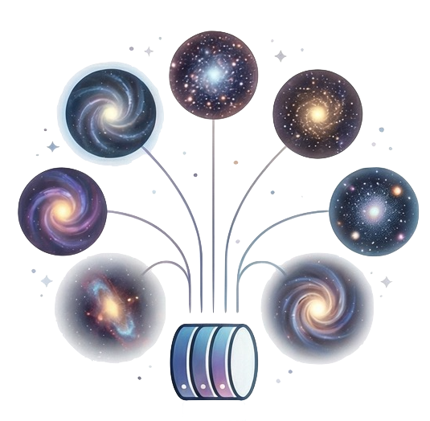
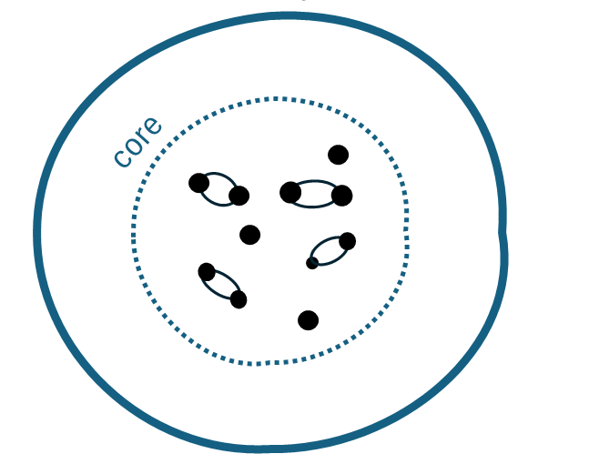
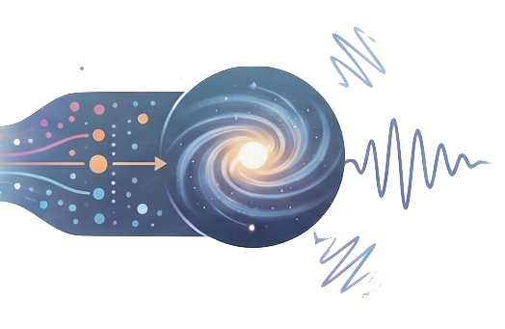
Project description
Gather existing numerical simulations of star clusters (N-body, Monte Carlo, semi-analytic)
Catalogue of all compact binaries, including also intermediate-mass black holes
Courtesy of L. Paiella
Define a common ground to perform a fair comparison among the simulations, and define a set of “standards” for new LISA-aimed projects
Combine the simulated data with models of Milky Way to create mock catalogues of sources.
Courtesy of B. Mestichelli
What are the properties of dynamically assembled binaries in star clusters in the Milky Way and its neighbourhood?
Assess the properties of compact binaries (black holes, neutron stars, and white dwarfs) formed in young, massive, and globular clusters in the Local Volume.

Slide 3
outline:
What we want to do and Why:
How we want to do it:
What is the status: statistics on the group, plots (Abbas, Sambaran, Tristan, Sara, etc)

Slide 4
Two active sub-groups:
(1) homogeneous comparison of simulations
(2) MW model for LISA

Slide 5
Status: the group & the data
JULY: gathering data from WG collabo

Slide 6
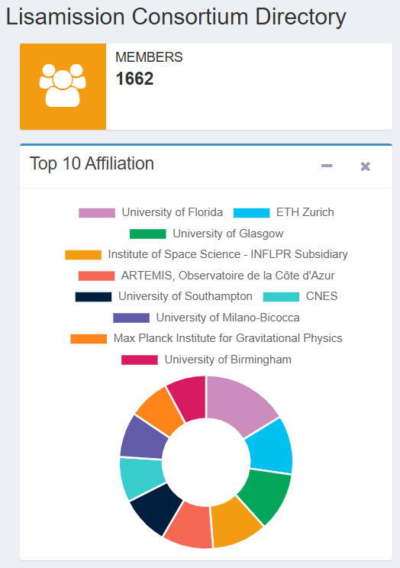
Why LISA and the Consortium need the project
We have >1600 members in LISA Consortium with expertise in all the topics related to this project. This offers a unique opportunity to gather people working on affine topics from different points of view.
Our project will permit us to assess the properties of sources visible to LISA and establish a common framework to untangle Galactic sources with a dynamical origin once LISA will be operational.
Once we established a common framework we can use LISA to unravel complex phenomenon taking place in the universe.

Slide 7
Timeline and deliverables
Timeline
February | List of members defined
April | Data acquired and shared
September | Defined the way to normalise the data
December | Convolved data with Milky Way and Local Volume models
Deliverables
Relevant raw outputs of numerical simulations
Common catalogue(s) of sources
Data analysis tool and pipeline used to combine the numerical models
Identify the peculiarities of dynamical sources for identification in future observations

Slide 8
Competences and size of the contributors’ group
Expertise needed
N-body, Monte Carlo, or semi-analytic modelling of star clusters and their compact object populations
Milky Way modelling and star cluster formation
Stellar evolution of single and binary stars
Data analysis and signal modelling for LISA
Facilities
Access to public numerical simulations of star clusters or Milky Way-like galaxies
Access to HPC resources
Size
A compact and active group of 10ish people (as compact as the sources and dynamically active as star clusters)

Slide 9
Interactions with other Consortium WGs
LISA UCB Catalogue Project
Lisa triples and CBPs
Comparing UCB catalogues for LISA with existing observations
Waveform parameter space for astrophysical sources?
Data standard for catalogs

Slide 10


Conclusions
We want to:
Characterize which systems are formed in dynamically active environments: define a standard for LISA
Convolve this standard with our understanding of the local cosmic volume
Write to us at astro-wg-2025-07@lisamission.org
To join fill this form

